Slide 1




Let’s Go Idle-Free!
Reducing Idling Around Our School

Slide 2
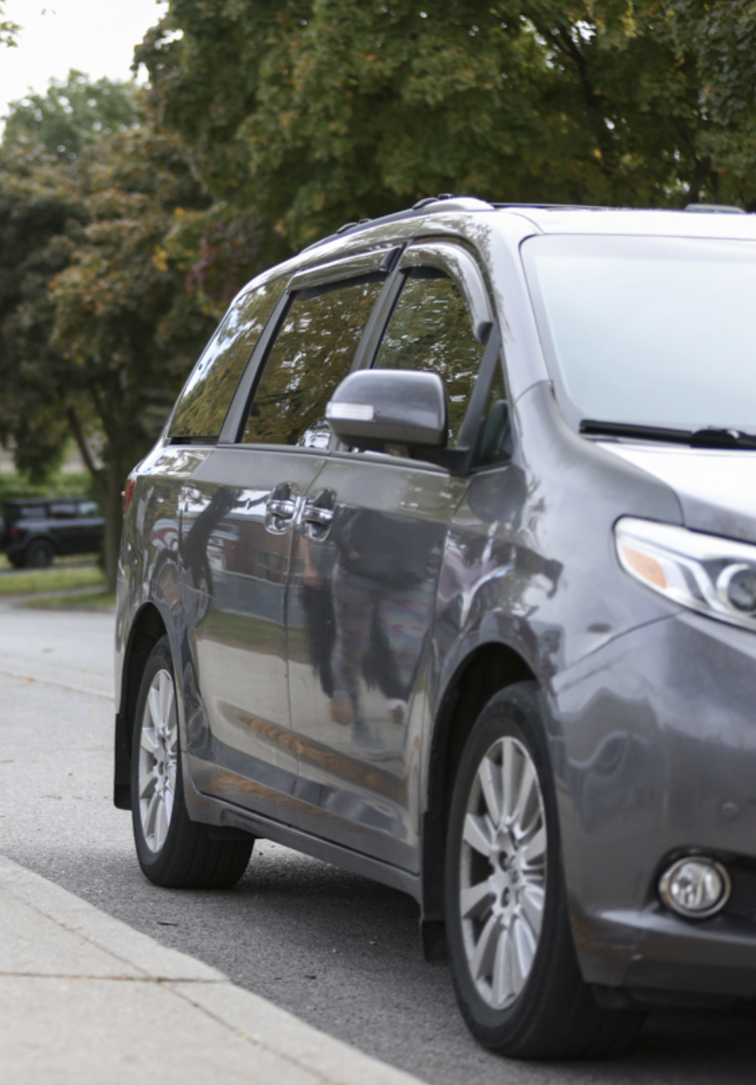
What is Idling?
Idling happens when a vehicle’s engine is running, but the car isn’t moving, such as while:
Waiting in the school pickup line
Stopping for a few minutes with the engine still on
If you’re stopped for more than 10 seconds, turn your engine off!
Image from ASRTS

Slide 3
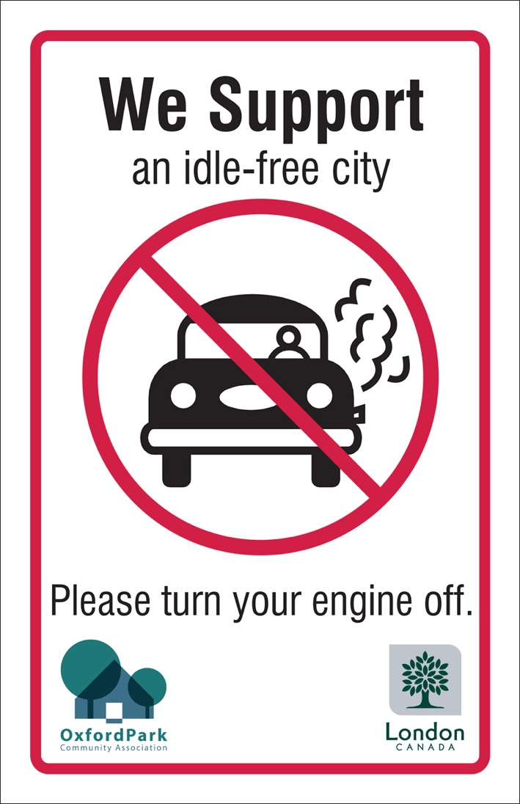
Why Stop Idling?
1. Health
2. Environment
Emissions can hurt young lungs
Less pollution and better air quality.
3. Safety
4. Money
Fewer cars = safer streets.
Idling wastes fuel.

Slide 4

Knowledge Check #1: Idling
What does idling mean?
A) When a car is parked and the engine is turned off B) When a car’s engine is running, but the car isn’t moving C) When a car is driving very fast D) When a car is stopped at a red light with the engine off

Slide 5
Knowledge Check #1: Idling
What does idling mean?
A) When a car is parked and the engine is turned off B) When a car’s engine is running, but the car isn’t moving ✅ C) When a car is driving very fast D) When a car is stopped at a red light with the engine off

Slide 6
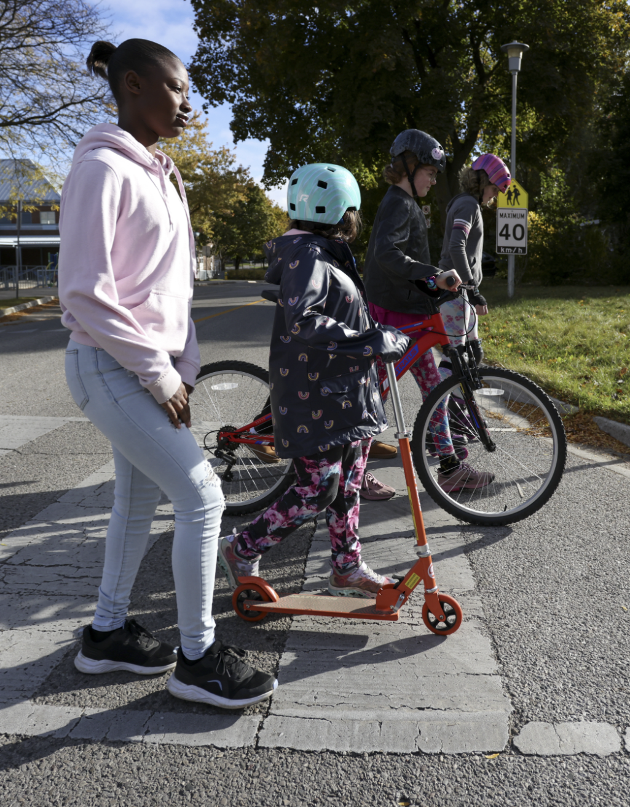
What is an Idle-Free School?
An idle-free school is a place where parents, staff, and bus drivers work together to reduce unnecessary idling on school property.
Together, we can build healthier, cleaner school environments for everyone.
Image from ASRTS

Slide 7



Core Messages
TURN
MOVE
WALK
The key and turn your car off.
Away from the curb.
Part of the way

Slide 8






Activity: Let’s Measure Idling!
As adapted from the ASRTS Anti-Idling Toolkit
Goal: Track how many cars idle at the kiss and ride drop-off, how long they idle, and calculate fuel wasted and CO₂ emitted.

Slide 9
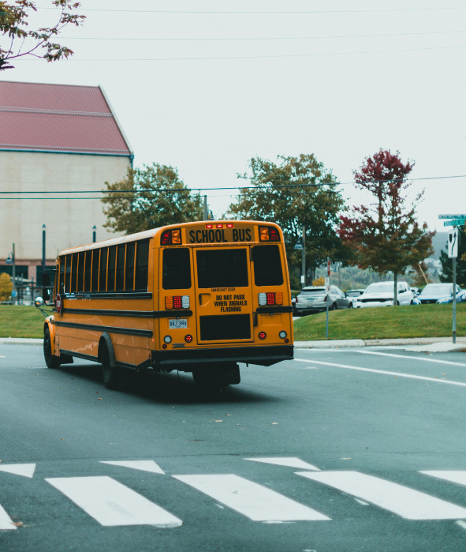

Materials
For this activity you will need:
Kiss & Ride idling data worksheet
Pencil or pen
Clipboards
Stopwatch
Calculator
Image from Canva

Slide 10
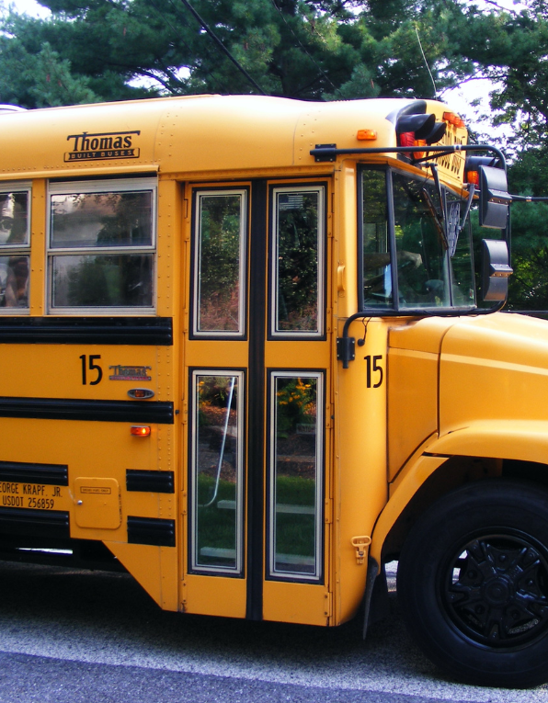
Step 1: Observe and Record
Choose a 10-minute observation period
Count:
→ Number of cars and buses idling
→ How long each one idles
Tip: Work in pairs – one records, one observes
Image from Canva

Slide 11
Step 2: Conversion Factors
Use the following conversion factors to calculate the amount of fuel wasted and CO2 emitted by each vehicle
Vehicle Type | Fuel Wasted /10 min | Fuel Wasted /min | CO2 Emitted /10 min | CO2 /min
Car | 0.1 L | 0.01L | 0.24 kg | 0.02 kg
Bus | 0.67 L | 0.067L | 1.9 kg | 0.19 kg

Slide 12
Example
Vehicle Type | Fuel Wasted /10 min | Fuel Wasted /min | CO2 Emitted /10 min | CO2 /min
Car | 0.1 L | 0.01L | 0.24 kg | 0.02 kg
Bus | 0.67 L | 0.067L | 1.9 kg | 0.19 kg
A car idles for 3 minutes → 0.01 x 3 = 0.03 L of fuel wasted, 0.02 x 3 = 0.06 kg CO₂ emitted
A bus idles for 7 minutes → 0.47 L fuel wasted, 1.33 kg CO₂ emitted
Notes:
Change example number and put calculation for bus as well

Slide 13
Knowledge Check #2: Calculations
Vehicle Type | Fuel Wasted /10 min | Fuel Wasted /min | CO2 Emitted /10 min | CO2 /min
Car | 0.1 L | 0.01L | 0.24 kg | 0.02 kg
Bus | 0.67 L | 0.067L | 1.9 kg | 0.19 kg
If two vehicles, a car and a bus, both idle for 5 minutes, how much CO₂ is emitted?
A) 1.07 kg B) 0.24 kg C) 2.14 kg D) 0.107 kg

Slide 14
Knowledge Check #2: Calculations
If two vehicles, a car and a bus, both idle for 5 minutes, how much CO₂ is emitted?
Car: 0.24 kg/2 = 0.12 kg
Bus: 1.9 kg/2 = 0.95 kg
Total = 0.12 kg + 0.95 kg = 1.07 kg CO₂ emitted
A) 1.07 kg ✅ B) 0.24 kg C) 2.14 kg D) 0.107 kg
1.07 kg would weigh about as much as a pineapple – but it would fill a HUGE amount of space because it’s a gas!

Slide 15

Step 3: Summarize Your Data
Make note of:
Total vehicles observed
Total fuel wasted
Total CO₂ emitted
Example: “During a 10-minute Kiss & Ride observation, 12 cars idled for an average of 5 minutes. That’s 0.6 L of fuel wasted and 1.44 kg of CO₂ released — just in 10 minutes!”

Slide 16
Step 4: Think-Pair-Share
Think: On your own think about why it’s important to turn off your engine instead of idling when you’re parked or waiting.
Pair: Discuss with a partner what drivers could do instead of idling and how that small action could make a difference.
Share: After discussing with your partner, share one reason with the class why turning off the engine helps keep our air cleaner and our community healthier.

Slide 17
Knowledge Check #4: Idling Prevention
Which of the following are good ways to avoid idling?
A) Remind drivers to turn off their engine when waiting to pick someone up B) Park and walk the last 5-10 minutes to school C) Turn off the car when stopped E) All of the above

Slide 18
Knowledge Check #4: Idling Prevention
Which of the following are good ways to avoid idling?
A) Remind drivers to turn off their engine when waiting to pick someone up B) Park and walk the last 5-10 minutes to school C) Turn off the car when stopped E) All of the above ✅

Slide 19
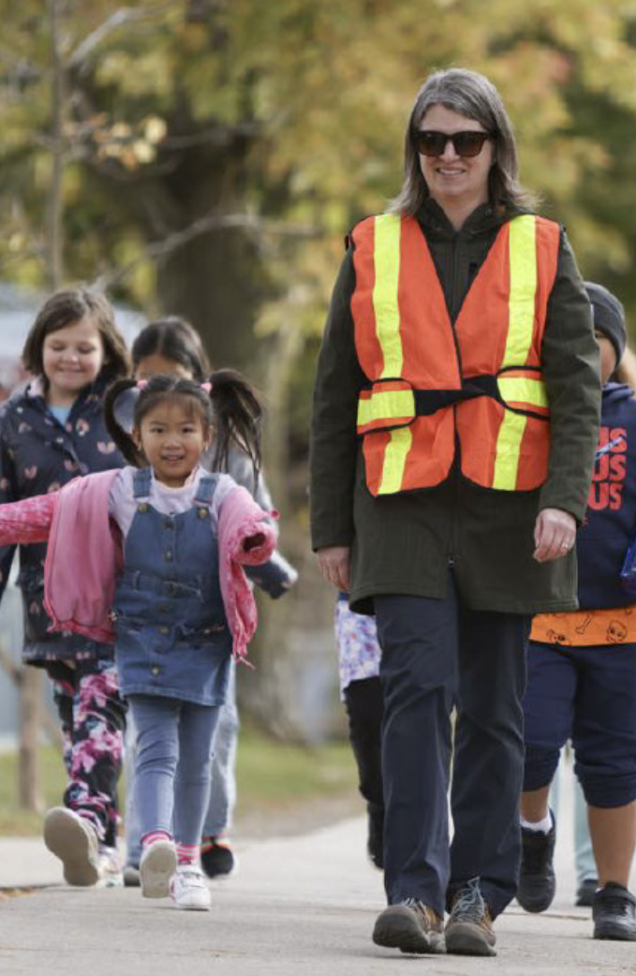
Thank You!
Have any Questions?
Email: info@activesaferoutes.ca.
Visit: http://activesaferoutes.ca/
CREDITS: This presentation template was created by Slidesgo, and includes icons & images by Canva
Adapted from Clean Air Partnership. (2009). Idle-Free: Campaign kit. Clean Air Partnership. Idle-Free Campaign Kit

